Slide 1
Exponential growth equation – in real life

Slide 2
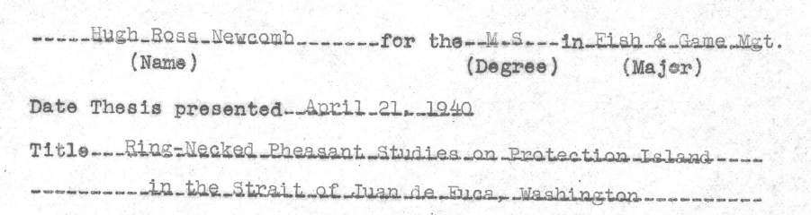
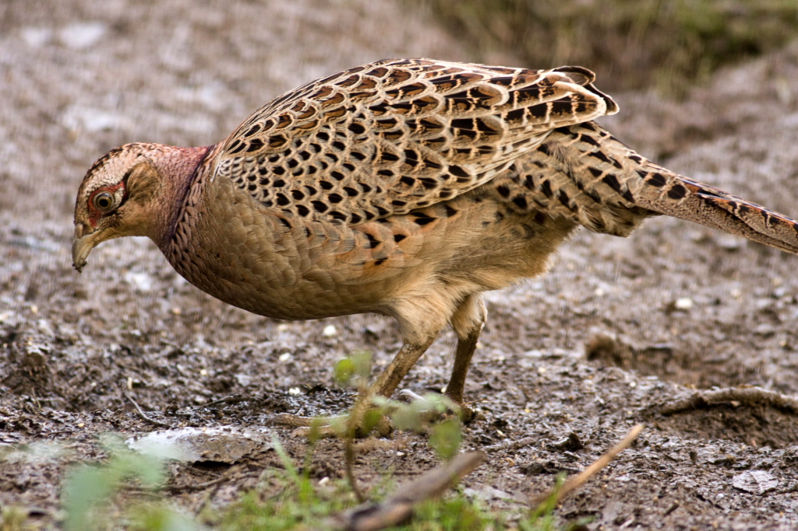
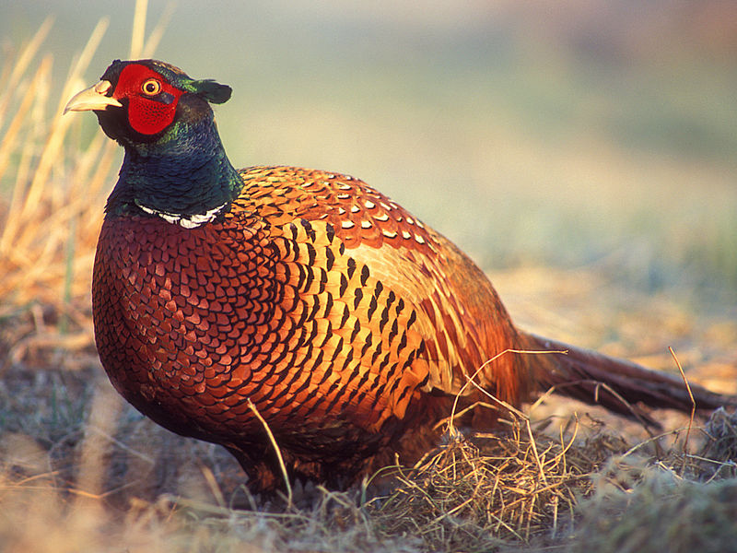
Newcomb, HR. 1940. Ring-necked pheasant studies on Protection Island in the Strait of Juan de Fuca, Washington. MS thesis. Oregon State University.
Video
Photo credit: Andy Vernon
Photo credit: Lukasz Lukasik

Slide 3
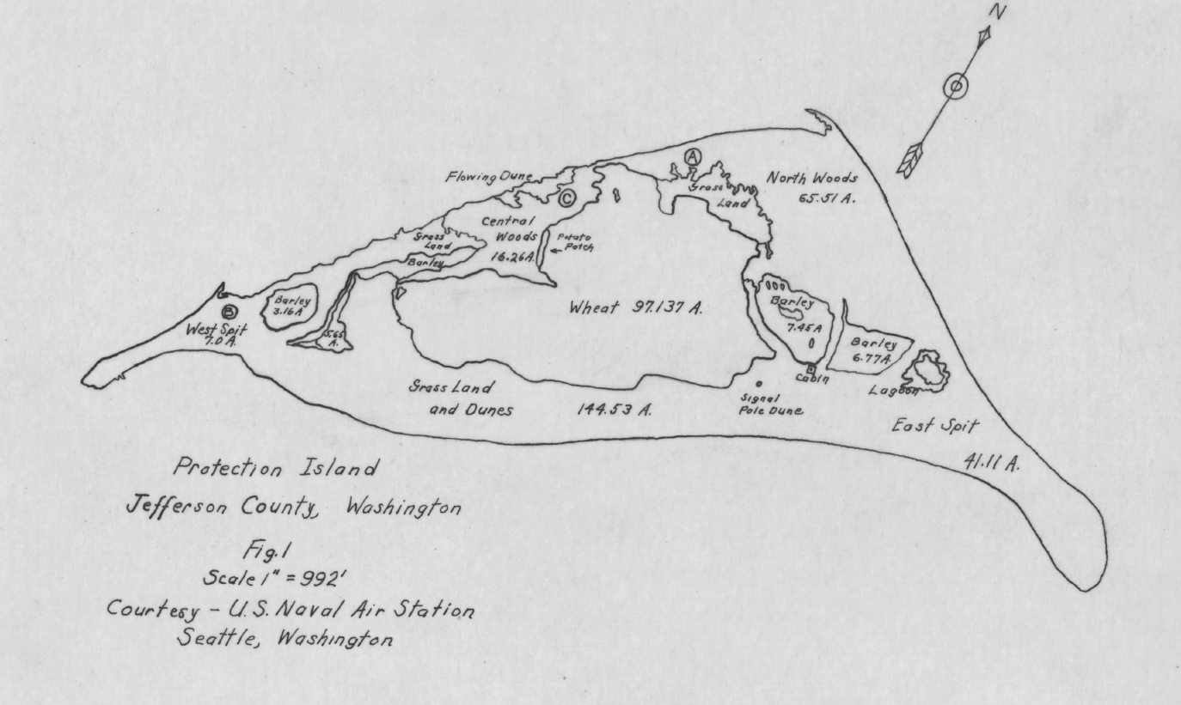
Newcomb, HR. 1940. Ring-necked pheasant studies on Protection Island in the Strait of Juan de Fuca, Washington. MS thesis. Oregon State University.

Slide 4
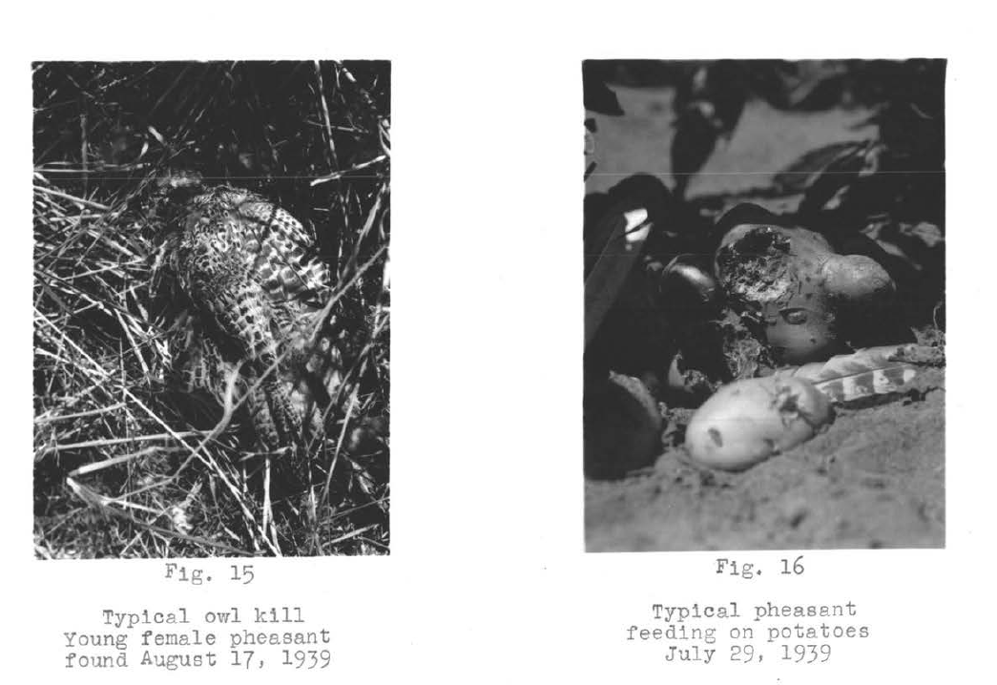
Newcomb, HR. 1940. Ring-necked pheasant studies on Protection Island in the Strait of Juan de Fuca, Washington. MS thesis. Oregon State University.

Slide 5
In May 1937, 10 pheasants were introduced to the island. Before the next breeding season there were 35.
November 10, 1938 a census estimated 110 pheasants.
October 13, 1939 a census estimated 400 pheasants.
Pheasant chicks are born during the summer.
Newcomb, HR. 1940. Ring-necked pheasant studies on Protection Island in the Strait of Juan de Fuca, Washington. MS thesis. Oregon State University.

Slide 6

N₀: initial population size
N_{t}: size of the population after t years at the time of census
Ideally, the census points should be exactly 1 year apart. When does the census occur on Protection Island? How does this relate to the biology of the pheasant?
What are the values of N₀, N₁ and N₂?
MS

Slide 7
Recall that for a population growing exponentially:
N_{t+1} : popn size next year (number)
N_{t}: Popn size this year (number)
b: per capita number of births each year (unitless)
d: fraction of popn that dies each year (unitless)
λ =1+ b-d: finite rate of population growth (unitless)

Slide 8
Between the 1938 and 1939 censuses, Newcomb observed that 17 out of 110 adult birds died.
d is fraction of popn that dies each year. What is d for the ring-tailed pheasant population on Protection Island?
Newcomb, HR. 1940. Ring-necked pheasant studies on Protection Island in the Strait of Juan de Fuca, Washington. MS thesis. Oregon State University.

Slide 9
Those questions had clear answers. Interpreting the information on reproduction from Newcomb’s MSc thesis is a lot more tricky – as is understanding what the parameter b actually means.

Slide 10
During the 1938 nesting season: 5.86 eggs/nest. 83.57% of eggs hatched.
During the 1939 nesting season: 8.73 eggs/nest. 64.58% hatched. Average number of chicks per clutch was 6.93.
You can assume the sex ratio is 50:50 male to female
Newcomb, HR. 1940. Ring-necked pheasant studies on Protection Island in the Strait of Juan de Fuca, Washington. MS thesis. Oregon State University.

Slide 11
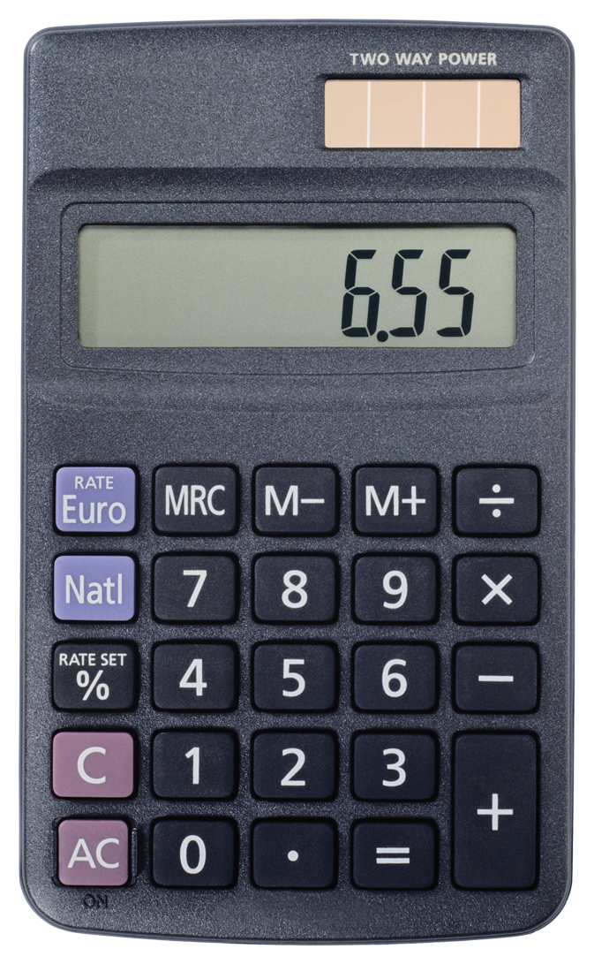
b: per capita number of births each year (unitless)
d: fraction of popn that dies each year (unitless)
λ = 1+b-d: finite rate of population growth (unitless)
What is the value of b?
What is the value of λ?
QR

Slide 12
b: per capita number of births each year (unitless)
d: fraction of popn that dies each year (unitless)
λ = 1+b-d: finite rate of population growth (unitless)
What is the value of b? Ans: 6.93/2 = 3.465
What is the value of λ? Ans: 1+3.465 – 17/110 = 4.31

Slide 13
(1)
(2)
(3)
Note: t is the time in years since the initial introduction. Each of the 3 formulas will give the same answer.
If the population grows exponentially, how many pheasants will there be in 1940?
How many pheasants will there be in 1942?
All of the formulas above are equivalent, but which formula is more useful? Which is easier to understand?

Slide 14
Some extra questions to think about at home:
Find the value of t when the population size equal to 1000?
For what values of λ does the population decrease?
What happens when λ=1?
Let td be the time when a population has doubled for its size at time t, i.e. N_{td} = 2N_{t}. Derive an expression for td.
When will the pheasant population have doubled from its size in 1939?

Slide 15
Exponential growth in discrete time
The equations we have seen so far are called ‘discrete time’. This equation is appropriate for populations that have regular, pulse reproduction.
For example, pheasants reproduce once per year in the summer.
Can you think of examples of other species that reproduce like this?
Notes:
Answer: fish, mammals, plants

Slide 16
Exponential growth in continuous time
Can you think of any species that reproduce continuously throughout the year?
These species are better modelled with a continuous time model
Notes:
Answer: bacteria; humans

Slide 17
Exponential growth in continuous time
Let N(t) be the popn size at time t
The slope of a graph of population size versus time
The instantaneous rate of change in the popn size, N(t)
If positive, the population is increasing in size. If negative, the population is decreasing in size

Slide 18
Exponential growth in continuous time
b: is the per capita birth rate (1/time)
d: is the per capita death rate (1/time)
r = b-d: intrinsic rate of natural increase (1/time)

Slide 19
Discrete time
Continuous time
The population is increasing if N_{t+1} > N_{t}
For what values of λ does the population size increase?
The population is increasing if > 0
For what values of r does the population size increase?
Notes:
ANSWER: Lambda > 1; r > 0

Slide 20
Solving the exponential growth equation – continuous time

Slide 21
Continuous time exponential growth
The population is growing exponentially with time
r = 0.5
What is the slope of the tangent line?

Slide 22
Discrete time
Continuous time
Used for populations that have regular pulse reproduction, e.g. pheasants
The population is increasing if N_{t+1} > N_{t}
λ is non-negative (positive or zero)
Popn grows if λ > 1
λ = 1+b-d and is called the finite rate of population growth
Used for populations that reproduce continuously, e.g. bacteria
The population is increasing if . > 0
r can be positive or negative
Popn grows if r > 0
r = b-d and is called the intristic rate of natural increase
Notes:
ANSWER: Lambda > 1; r > 0

Slide 23
Summary
Exponential growth assumes that all individuals in the population have the same chance of dying and produce the same number of offspring. These do no change over time.
We can use the mathematical formulas to predict the size of the population in the future

Slide 24
Barraquand et al. 2013. Lack of quantitative training among early career ecologists: a survey of the problem and potential solutions. PeerJ
Survey of 937 early-career scientists who studied biology as an undergraduate
75% not satisfied with their understanding of mathematical models
75% felt the level of mathematics was “too low” in their ecology classes
90% wanted more mathematics classes for ecologists
95% wanted more statistics classes

Slide 25
Required reading for next class:
9-21 in Vandermeer, JH and Goldberg, DE. 2013. Population Ecology: First Principles (2nd Edition).
Vandermeer 2010. How poulations grow: The exponential and logistic equations. Nature Education Knowledge Project
Levin, S. (Ed) 2009Density dependence and single-species population dynamics in Population Ecology. Princeton Guide to Ecology. Princeton University Press.

